Slide 1
OstraCam II CDR
Paul Killam, Oliver Thio, Christina Lim
Notes:
Introductions by all

Slide 2
OstraCam I
The purpose last year was to design a system that is able to record low-light video of bioluminescent ostracods and document data about the oceanic environment at the time
Data saved to be analyzed later
Issues they ran into on the field
Camera re-calibration and maintenance
Lack of feedback from device
Ease of use by someone in full diving gear (IR remote, etc..)
Poor quality from the cameras in-situ
Overall weren’t able to produce much valuable data
Notes:
Presenter:Oliver

Slide 3
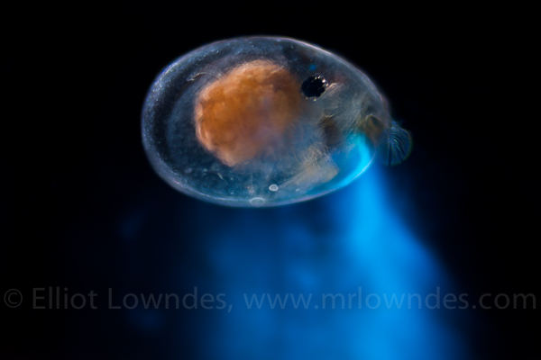
The Ostracod:
The size of a sesame seed
Bioluminescent
Thousands of species
Notes:
Presenter: Paul

Slide 4
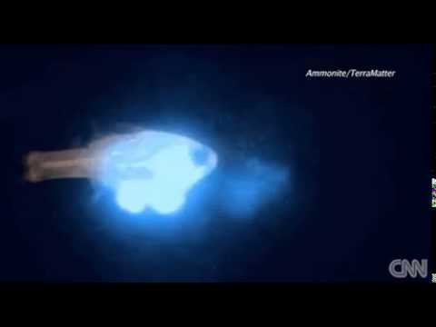
Notes:
Presenter: Paul

Slide 5
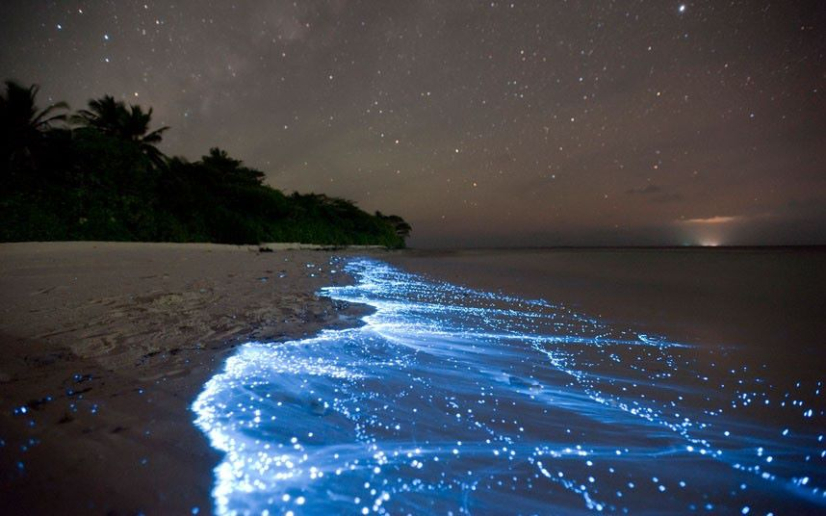
Notes:
Presenter: Paul

Slide 6
The Science:
By cataloging the bioluminescent properties of different species of ostracod and sequencing their genome, we can identify the genetics behind bioluminescence.
Being able to control and implant bioluminescence would give biology researchers another tool for genetic research.
Unforeseen medical and scientific benefits.
Notes:
Presenter: Paul

Slide 7
Team members
Paul Killam - Team lead, Firmware, Computer Vision
Oliver Thio - Software, MATLAB, Computer Vision
Christina Lim - Hardware, DxDesigner, ExpeditionPCB
Notes:
Presenter: Paul

Slide 8
Goals for OstraCam II
How we’re improving it
Transitioning to a more appropriate microcontroller
Adding additional sensors for more data collection
Adding power indicating LEDs
Developing external IR trigger system
Working on distortion issues with the cameras
Convincing the Marine Biology Department this is a good idea
Developing image processing techniques to enhance already-present data
Extract useable data from last year's images
Notes:
Presenter: Oliver

Slide 9
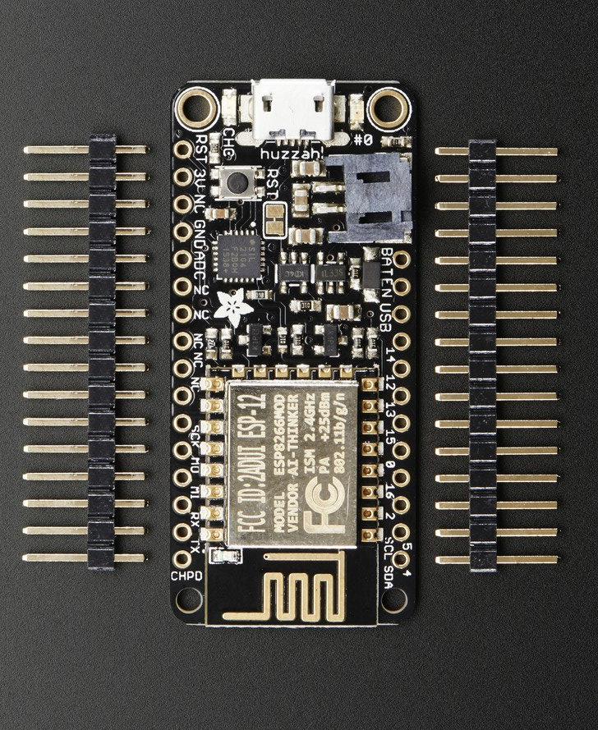
Processor
New microcontroller: ESP8266
Adafruit feather HUZZAH development board with USB programming
Board to be mounted into PCB headers
Arduino compatible
Has embedded RTC
500 mA peak output current
3.3V logic
Notes:
Presenter: Christina

Slide 10
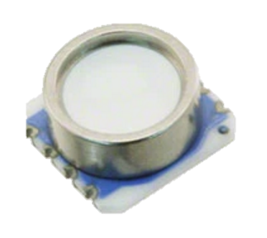
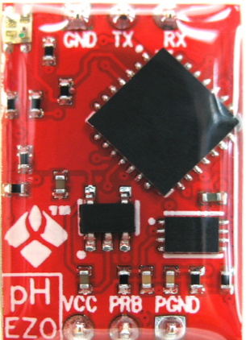
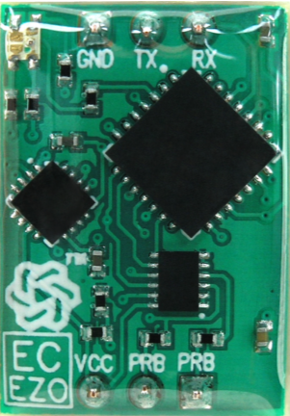
Sensors
Underwater pressure and temperature sensor
MS5803-30BA
0-30 bar
Low power, 1uA
EZO Sensors
pH
Max 14.5 mA
Salinity
Max 35 mA
Interface to external probes through BNC connectors
Notes:
Presenter: Christina

Slide 11
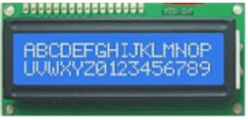
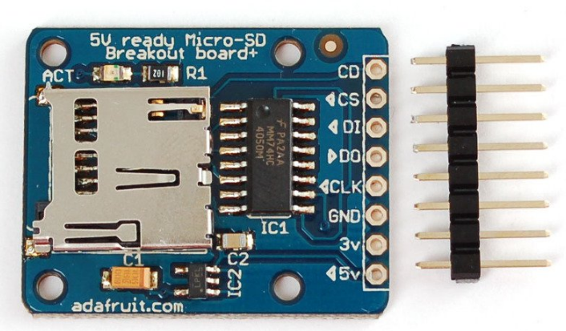
Other Modules
LCD Display
Menu interface to indicate status
GPS
Triggered above water before submerging the system
SD Board
MicroSD 4GB
SPI
IR Receiver
External to PCB
Triggers power to system from 12V battery
Notes:
Presenter: Christina

Slide 12
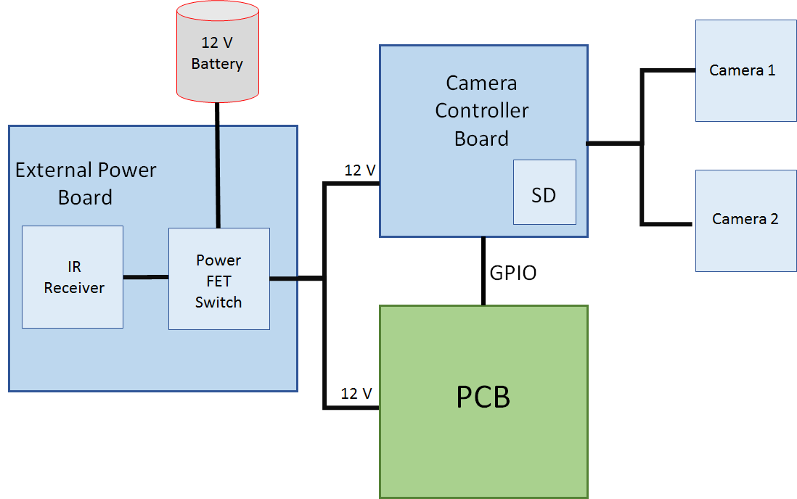
Block Diagram of External Components
Notes:
Presenter: Christina

Slide 13
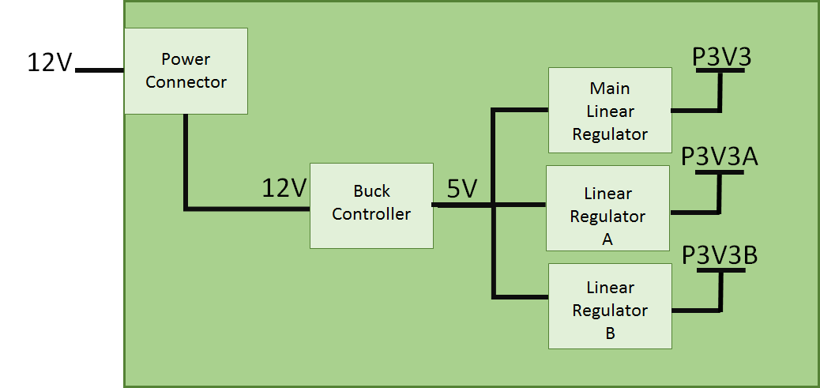
Block Diagram of PCB Power
Notes:
Presenter: Christina

Slide 14
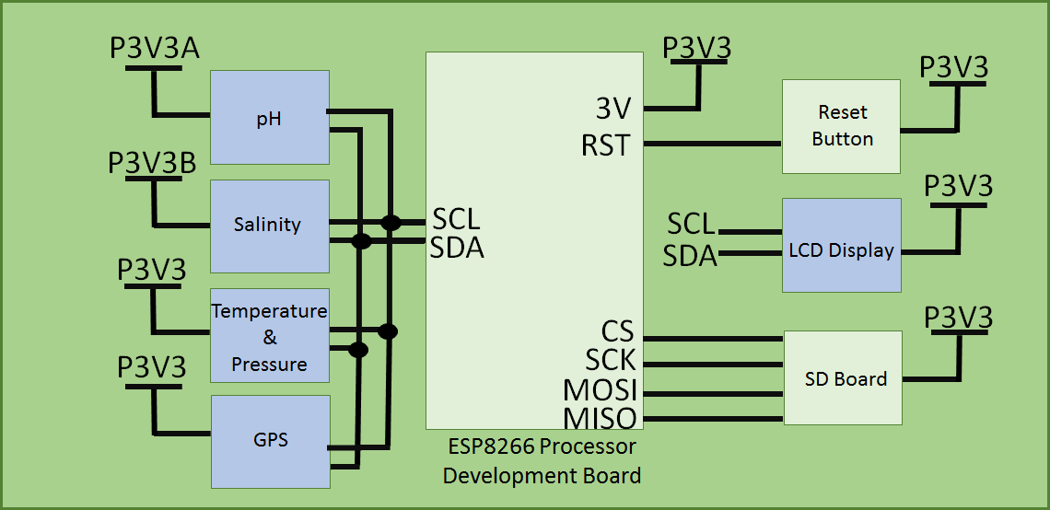
Block Diagram of PCB Main
Notes:
Presenter: Christina

Slide 15


Raw Footage from OstraCam I
Notes:
Presenter: Paul

Slide 16


Postprocessed Footage from OstraCam I
Notes:
Presenter: Paul

Slide 17
Camera System Variants
The current camera system is not living up to expectations, so we've begun looking into alternatives:
Tweak the current camera system to get images of the expected quality.
Replace one of the cameras with a higher quality (more expensive) one, creating an asymmetrical stereo system like in some modern camera phones.
Add a new camera without removing another one, creating a triple-camera system.
Notes:
Presenter: Paul

Slide 18
Software and firmware issues to be addressed this year
Recalibration for every data set due to bad 3D-printed camera mountings
Frame synchronization
Postprocessing fishbowl distortion correction
Sub-pixel interpolation to maximize image quality
3-D mapping
Notes:
Presenter: Paul (recalibration, frame sync, postprocessing, interpolation) then Oliver

